Slide 1

Scalable Statistical Relational Learning for NLP
William Wang
CMU → UCSB
William Cohen
CMU
joint work with:
Kathryn Rivard Mazaitis

Slide 2
Three Areas of Data Science
Representation
Scalability
Machine Learning
Probabilistic logics,
Representation learning
Abstract Machines, Binarization
Scalable Statistical Relational Learning
Scalable Learning

Slide 3
Our Work
We modify first-order logic reasoning to handle complexity.
We design statistical machine learning algorithms to deal with uncertainty and learn from past experiences.
We investigate scalable inference algorithms for real-world problems.

Slide 4
Overview
Statistical Relational Learning
Programming w. Personalized PageRank (ProPPR)
Scalable Reasoning
Parameter Learning
Structure Learning
Conclusion for Part 2

Slide 5
Statistical Relational Learning

Slide 6
First-Order Logic
Formula
Atom
Variable
Grounding: map the entities from knowledge graph
to logical formulas.
links(ibm,watson) ∨ links(watson,ibm) → similar(ibm,watson)

Slide 7
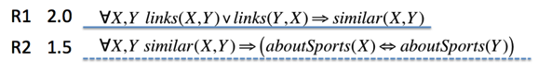

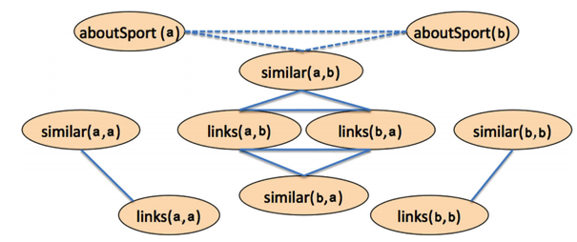
Probabilistic First-Order Logic
Learn parameters for formulas to improve inference results.
(e.g., Markov Logic Networks) (Richardson and Domingos,2006)
a
Ground
Formula
=
Graph
b

Slide 8
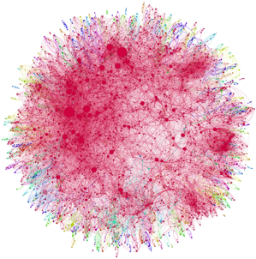
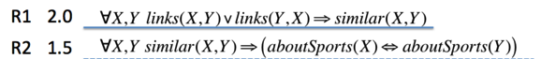

Challenges
Learn parameters for logical clauses.
(e.g., Markov Logic Networks) (Richardson and Domingos,2006)
Inference is often intractable:
Network size is O(nª), where a = #args.

Slide 9
ProPPR: A Scalable Probabilistic Logic
CIKM 2013 Best Paper Honorable Mention

Slide 10
ProPPR Overview
Semantics: Prolog.
Search Graph:
edges = formulas (as feature vectors);
nodes = intermediate proof states.
Inference:
very fast approx. personalized PageRank.
Learning:
parallel stochastic gradient descent.

Slide 11
An Example ProPPR Program
Probabilistic programming w. ProPPR.
coderUsesPL(X,Y) :- colleague(X,Z), coderUsesPL(Z,Y).
Head
Body
{ #Colleague(CL) }
Each formula has a feature function which
produces a set of features when being used.
Features are coupled with parameters during learning, which indicates the importance of each formula.
#Colleague(CL) does not mean number of colleagues: it’s more like a label for formula.

Slide 12




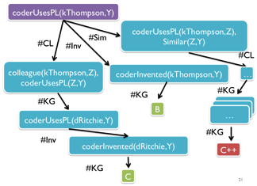
Query
KG
B
C
C++
coderUsesPL(X,Y) :- colleague(X,Z), coderUsesPL(Z,Y). {#CL}
coderUsesPL(X,Y) :- coderInventedPL(X,Y). {#Inv}
coderUsesPL(X,Y) :- coderUsesPL(X,Z),similar(Z,Y). {#Sim}
similar(X,Y) :- similar(X,Z),similar(Z,Y). {#TC}
Program + Knowledge Graph + Query define a proof graph, where nodes are conjunctions of goals and edges are labeled with sets of features.

Slide 13
coderUsesPL(kThompson,Y)
coderUsesPL(kThompson,Z),
Similar(Z,Y)
#Sim
#CL
#Inv
#CL
colleague(kThompson,Z),
coderUsesPL(Z,Y)
coderInvented(kThompson,Y)
…
#KG
#KG
#KG
…
B
…
…
coderUsesPL(dRitchie,Y)
#KG
#Inv
coderInvented(dRitchie,Y)
C++
#KG
C

Slide 14

High probability
Short,
direct paths
Low probability
High probability
Longer, indirect paths
Personalized PageRank defines a distribution over nodes.
Transition probabilities determine which path to take.
Learned via pSGD
Very fast approximate methods for PPR

Slide 15
Theoretical Guarantee
Approximate PPR proof algorithm
Incrementally add edges;
probability shifted from residual to the PPR vector.
Grounding (proof tree) size is O(1/αε)
α is the reset probability;
ε is the approximation error.

Slide 16
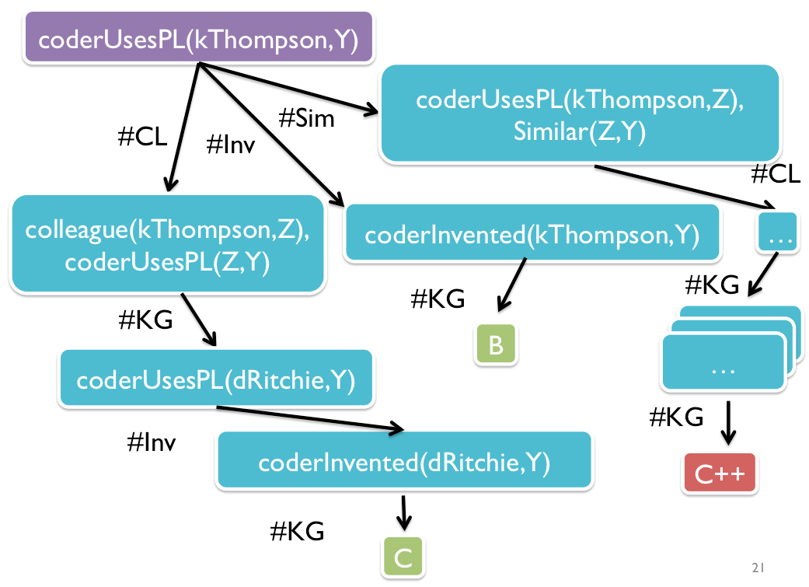

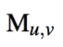
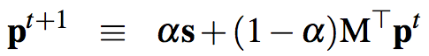
Weighted Personalized PageRank
f(
)
•
=
Z
PPR
α

Slide 17
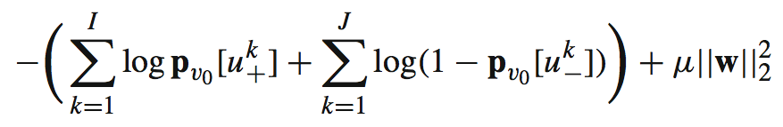
Asynchronous SGD Learning
ppr=1
ppr=0
ppr=1

Slide 18

Experimental Setup
Task: Citation Matching.
Input: a citation query, and a bibliography file.
Query:
sameCitation( ,?)
Output: a ranked list of matching citations.
Evaluation: area under the ROC curve (AUC).
Dataset: Cora – 1.2K citations.

Slide 19
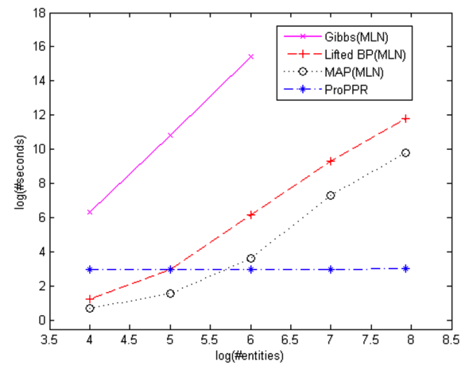
Inference Time Comparison
ProPPR’s inference time is independent of the size of the graph (Wang et al., 2013).

Slide 20
Accuracy: Citation Matching
AUC scores: 0.0=low, 1.0=hi
w=1 is before learning

Slide 21
Experimental Setup
Task: Inference in a large knowledge graph.
Input: query, i.e., president(obama,?)
Output: a ranked list of answers.
Evaluation: area under the ROC curve (AUC).
Dataset: three NELL subsets – 1M entities.
Temporal split for training and test sets.

Slide 22
Results: AUC on NELL subsets Wang et al. (Machine Learning 2015)
Lao et al. (2012)
Train on 1K Google subset:
MLNs: 8604.3s.
ProPPR: 4.7s.
Inference Time on 10K subset:
MLNs: 192 seconds.
ProPPR: 38 seconds.
* KGs overlap a lot at 1M entities

Slide 23
Demo

Slide 24
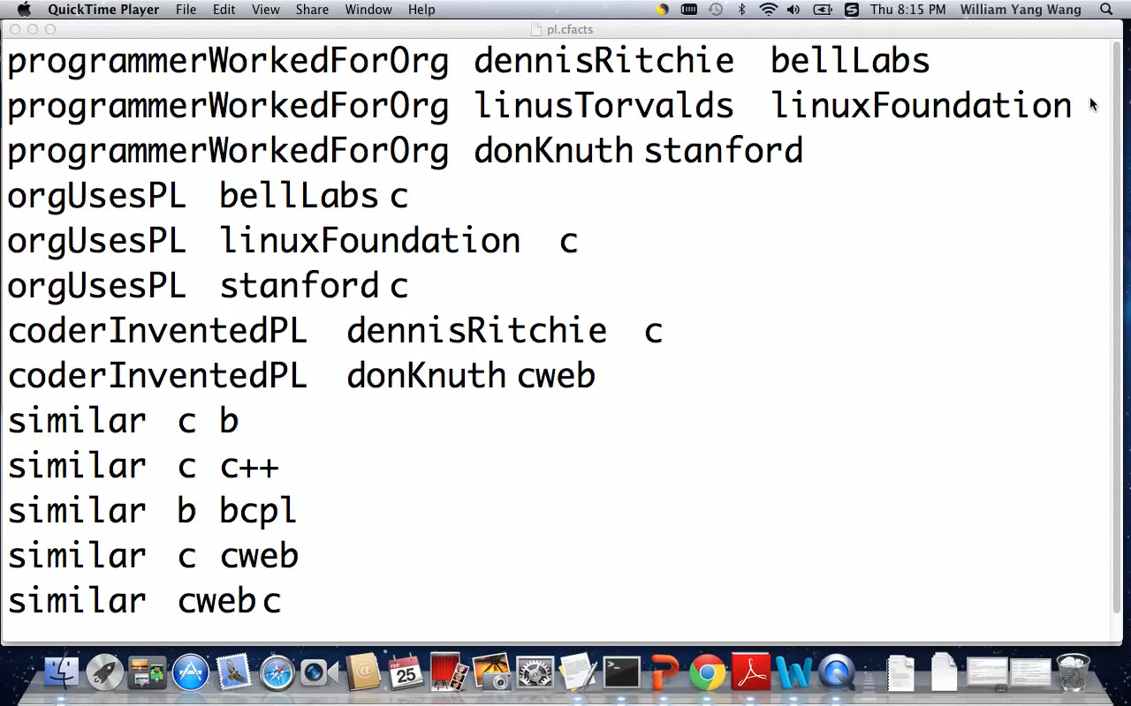

Slide 25
Structure Learning
CIKM 2014 and IJCAI 2015

Slide 26
Not to Be Confused…
Structured Prediction (NLP/ML): predicting structured objects as output, in contrast to simple classification/regression. E.g., predicting a parse tree.
Structure Learning (ML/AI): automatically discovering the structure of a network/model/program from data.

Slide 27




Problem Definition
Task: automatically induce probabilistic programs from knowledge graphs.
Input: Knowledge Graph.
Output: Program.
coderUsesPL(X,Y) :- colleague(X,Z), coderUsesPL(Z,Y). {#CL}
coderUsesPL(X,Y) :- coderInventedPL(X,Y). {#Inv}
coderUsesPL(X,Y) :- coderUsesPL(X,Z),Similar(Z,Y). {#Sim}
Similar(X,Y) :- Similar(X,Z),Similar(Z,Y). {#TC}
B
C
C++

Slide 28
Structure Learning in PGMs
Chow-Liu for SL in Bayesian Networks
Compute weights for each possible edge;
Find a maximum weight spanning tree (MST);
Give directions to edges.
Core idea: find a structure of PGM that maximizes the data likelihood.

Slide 29
Structure Learning in MLNs
How to learn the structure of a Markov network?
… not too different from learning structure for a Bayes network: discrete search through space of possible graphs, trying to maximize data probability….
H/T Pedro Domingos

Slide 30
Structure Learning in MLNs
Initial state: Unit clauses or hand-coded KB
Operators: Add/remove literal, flip sign
Evaluation function: Pseudo-likelihood + Structure prior
Search: Beam, shortest-first, bottom-up [Kok & Domingos, 2005; Mihalkova & Mooney, 2007]
H/T Pedro Domingos

Slide 31
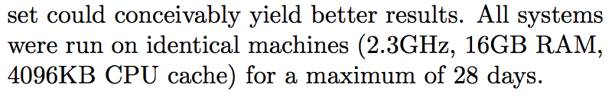
Challenge
Runtime: search is very expensive.
e.g. Markov Logic Networks
grounding for candidate formulas;
for a dataset with 42K triples,
Kok and Domingos (ICML 2010)

Slide 32
Our Approach
Build a meta language and reduce the structure learning to parameter learning.
Instead of searching an answer for a known relation, we search for unknown relations that meet our constraints.
2. Transform triples into quadruples.
coderUsesPL(dennisRitchie,c)
relation(coderUsesPL,dennisRitchie,c)

Slide 33
Structure Learning Templates
Entailment: P(X,Y) :- R(X,Y).
e.g., coderUsesPL(X,Y) :- coderInventedPL(X,Y).
Inversion: P(X,Y) :- R(Y,X).
e.g., orgHasCoder(X,Y) :- coderWorkedForOrg(Y,X).
Chain: P(X,Y) :- R1(X,Z),R2(Z,Y).
e.g., coderUsesPL(X,Y) :- coderInvented(X,Z),sim(Z,Y).
Advantages of templates: concise and extendable.

Slide 34
A Structure Learning Example
An example task: learning entailments.
In the first section, formulas are known and we always search for a known relation.
e.g., coderUsesPL(dennisRitchie,?)
Here, we want to learn unknown relation(s) that satisfies our formula template constraints.
e.g., which relation entails coderUsesPL?

Slide 35
interp(coderUsesPL,kThompson,Z)
#Entail
rel(Q, kThompson,Z),
entail(coderUsesPL,Q)
We learned:
coderUsesPL(X,Y):-coderInventedPL(X,Y).
entail(coderUsesPL,
prgmrWorkedForOrg)
#KG
rel coderInventedPL kThompson b
#KG
rel prgmrWorkedForOrg kThompson bellLabs
entail(coderUsesPL,
coderInventedPL)
#entail(coderUsesPL,
prgmrWorkedForOrg)
#entail(coderUsesPL,
coderInventedPL)
Z=bellLabs
Z=b

Slide 36
Iterated Structural Gradient
1. Build a meta theory T1 (three templates) with a large number of possible formulas.
2. Use parameter learning (gradient) to discover which ones you really do need.
3. Add these to T1 with the original templates.
4. Repeat.

Slide 37
Experimental Setup
Training
Input: relational triples.
Output: plausible inference formulas with w.
Testing
Input: queries, e.g., president(obama,?)
Output: a rank list for each query.
Evaluation: mean averaged precision (MAP).
Datasets: (1) Hinton’s family
(2) UMLS -- 6K triples

Slide 38
Results on Family Relations

Slide 39
Results on UMLS
Causes(X,Z)∧Associated_with(Z,Y) → Affects(X,Y)
Complicates(X,Z)∧Complicates(Z,Y) → Affects(X,Y)
Produces(X,Z)∧Disrupts(Z,Y) → Affects(X,Y)

Slide 40
Discussions
PRA (Lao et al., 2012) vs. ProPPR?
ProPPR performs joint recursive learning of multiple relations, whereas PRA learns from KB facts only.
PRA
athletePlaysInLeague(A,L) :- factAthleteInTeam(A,T),factTeamInLeague(T,L).
ProPPR
athletePlaysInLeague(A,L) :-
factAthleteInTeam(A,T),factTeamInLeague(T,L).
athletePlaysInLeague(A,L) :-
athleteInTeam(A,T),teamInLeague(T,L).
teamInLeague(T,L) :-
teamHasAthlete(T,A), athletePlaysInLeague(A,L).
Notes:
Apologize that the talk is a bit dense. Actually my advisor just gave a lecture series on about the same material in 3 hrs. So I am happy to give more details offline.

Slide 41
Discussions
Do you ever want to use MLNs again?
For scalability: ProPPR builds query-dependent proof graphs, and searches answers with bounded depth.
For expressiveness: MLNs handle first-order logics with negations.
Notes:
Apologize that the talk is a bit dense. Actually my advisor just gave a lecture series on about the same material in 3 hrs. So I am happy to give more details offline.

Slide 42
Conclusion For Part 2
We introduce a scalable probabilistic logic;
We show an efficient structure learning method for statistical relational learning;
Our method outperforms state-of-the-art KG reasoning approaches.
Notes:
Apologize that the talk is a bit dense. Actually my advisor just gave a lecture series on about the same material in 3 hrs. So I am happy to give more details offline.

Slide 43
Reference MLNs Richardson, M., & Domingos, P. (2006). Markov logic networks. Machine learning, 62(1-2), 107-136. Kok, S., & Domingos, P. (2005, August). Learning the structure of Markov logic networks. In Proceedings of the 22nd international conference on Machine learning (pp. 441-448). ACM. Mihalkova, L., & Mooney, R. J. (2007, June). Bottom-up learning of Markov logic network structure. In Proceedings of the 24th international conference on Machine learning (pp. 625-632). ACM. Kok, S., & Domingos, P. (2010). Learning Markov logic networks using structural motifs. In Proceedings of the 27th international conference on machine learning (ICML-10) (pp. 551-558).
Notes:
Apologize that the talk is a bit dense. Actually my advisor just gave a lecture series on about the same material in 3 hrs. So I am happy to give more details offline.

Slide 44
Reference ProPPR Wang, W. Y., Mazaitis, K., & Cohen, W. W. (2013, October). Programming with personalized pagerank: a locally groundable first-order probabilistic logic. In Proceedings of the 22nd ACM international conference on Conference on information & knowledge management (pp. 2129-2138). ACM. Wang, W. Y., Mazaitis, K., Lao, N., & Cohen, W. W. (2015). Efficient inference and learning in a large knowledge base. Machine Learning, 100(1), 101-126. Wang, W. Y., Mazaitis, K., & Cohen, W. W. (2014, November). Structure learning via parameter learning. In Proceedings of the 23rd ACM International Conference on Conference on Information and Knowledge Management (pp. 1199-1208). ACM. Wang, W. Y., Mazaitis, K., & Cohen, W. W. (2015, July). A soft version of predicate invention based on structured sparsity. In Proceedings of the 24th International Joint Conference on Artificial Intelligence (IJCAI 2015), Buenos Aires, Argentina.
Notes:
Apologize that the talk is a bit dense. Actually my advisor just gave a lecture series on about the same material in 3 hrs. So I am happy to give more details offline.

Slide 45
Reference PRA Lao, N., Subramanya, A., Pereira, F., & Cohen, W. W. (2012, July). Reading the web with learned syntactic-semantic inference rules. In Proceedings of the 2012 Joint Conference on Empirical Methods in Natural Language Processing and Computational Natural Language Learning (pp. 1017-1026). Association for Computational Linguistics.
Notes:
Apologize that the talk is a bit dense. Actually my advisor just gave a lecture series on about the same material in 3 hrs. So I am happy to give more details offline.

Slide 46
Questions for Part 2?
https://github.com/TeamCohen/ProPPR
yww@cs.cmu.edu

Slide 47
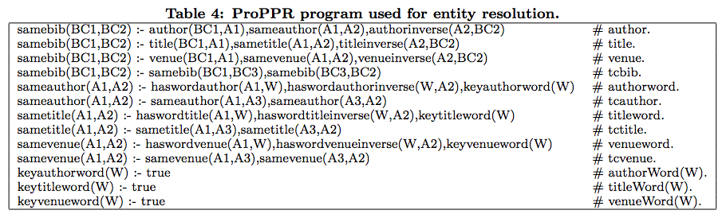
Cora Program

Slide 48
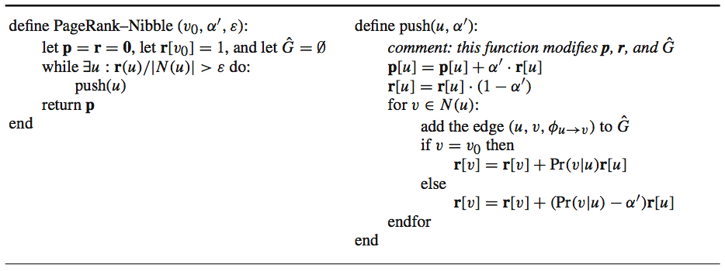
PageRank-Nibble Algorithm
ProPPR’s bound can be proved by noting that initially ||r||₁ = 1, and also that ||r||₁ decreases by at least α ε|N(u_{i})| on the ith push.

